Slide 1
COMP28112 Lecture 11
Fault Tolerance - Transactions

Slide 2
Key Definitions
“A characteristic feature of distributed systems that distinguishes them from single-machine (centralized) systems is the notion of partial failure”. [Tanenbaum, p.321]
The goal is to tolerate faults, that is, to operate in an acceptable way, when a (partial) failure occurs.
Being fault tolerant is strongly related to dependability:
  “Dependability is defined as the trustworthiness of a computing system which allows reliance to be justifiably placed on the service it delivers” [IFIP 10.4 Working Group on Dependable Computing and Fault Tolerance, http://www.dependability.org]

Slide 3
Requirements for Dependability
Availability: the probability that the system operates correctly at any given moment.
Reliability: length of time that it can run continuously without failure.
Safety: if and when failures occur, the consequences are not catastrophic for the system.
Maintainability: how easily a failed system can be repaired.

Slide 4
Types of Failures
Crash:
  Server halts!
Omission failures:
  Server fails to respond to incoming requests
  Server fails to receive incoming messages
  Server fails to send messages
Response failures:
  A server’s response is incorrect
Timing failures:
  Server fails to respond within a certain time
Arbitrary (byzantine) failures:
  A component may produce output it should never have produced (which may not be detected as incorrect) – arbitrary responses at arbitrary times.
Benign (i.e., omission/timing) failures are by far the most common; we’ll see problems related to byzantine failures later on.

Slide 5

The two generals’ problem (or paradox)…
(pitfalls and challenges of communication with unreliable links…)
Two armies, each led by a general, are preparing to attack a village. The armies are outside the village, each on its own hill. The generals can communicate only by sending messengers passing through the valley.
The two generals must attack at the same time to succeed!
http://en.wikipedia.org/wiki/Two_Generals'_Problem

Slide 6
Failure masking using redundancy
Physical redundancy:
  A well-known engineering technique (to give an extreme example, B747s or A380s have four engines but – subject to certain conditions – can fly on three)
  Even nature does it!
Time redundancy:
  An action is performed, if need be, again and again.
  Especially helpful when faults are transient and intermittent.
Information redundancy:
  e.g., send extra bits when transmitting information to allow recovery.

Slide 7
Redundancy…
…creates several problems:
  Consistency of replicas (e.g., all data need to be updated).
  Should improve (overall) system performance.
  (we’ll return to these!)
…costs money!
But, above all:
We still need to make sure that any failure won’t leave our system in an inconsistent (corrupted) state!

Slide 8
Example: A Simple Application
(a client communicating with a remote server)
Transfer £100 from account 1 to account 2
  x = read_balance(1);
  y = read_balance(2);
  write_balance(1, x – 100);
  write_balance(2, y + 100);
Crashes can occur at any time during the execution
What problems can arise because of this?

Slide 9
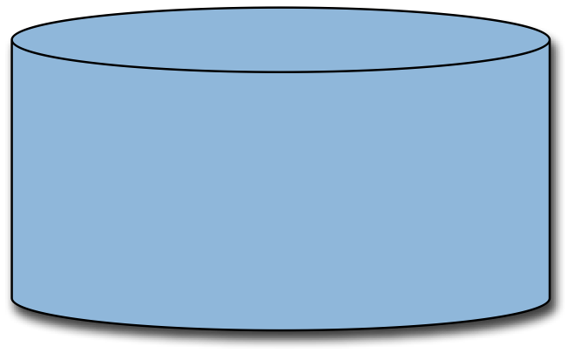
Crash
x = read_balance(1);
Acct | Balance
1 | 200
2 | 100
Acct | Balance
1 | 100
2 | 100
y = read_balance(2);
Acct | Balance
1 | 100
2 | 200
CRASH
CRASH
CRASH
CRASH
write_balance(1, x - 100);
write_balance(2, y + 100);

Slide 10
All-or-Nothing
Either ALL operations execute or NONE
  x = read_balance(1);
  y = read_balance(2);
  write_balance(1, x - 100);
  write_balance(2, y + 100);
The sequence of operations MUST execute as an ATOMIC operation

Slide 11
Concurrent Users
Multiple users can be transferring funds simultaneously. What problems can arise because of this?
Transfer £100 from acct 1 to 2
x = read_bal(1)
y = read_bal(2)
write_bal(1, x-100)
write_bal(2, y+100)
Transfer £300 from acct 1 to 2
u = read_bal(1)
v = read_bal(2)
write_bal(1, u-300)
write_bal(2, v+300)

Slide 12
Possible Sequence of Events
1 | x = read_bal(1)
2 | u = read_bal(1)
3 | v = read_bal(2)
4 | write_bal(1, u-300)
5 | y = read_bal(2)
6 | write_bal(1, x-100)
7 | write_bal(2, y+100)
8 | write_bal(2, v+300)
Acct | Balance
1 | 100
2 | 200
Acct | Balance
1 | -200
2 | 200
Acct | Balance
1 | 0
2 | 200
Acct | Balance
1 | 0
2 | 300
Acct | Balance
1 | 0
2 | 500

Slide 13
What you expect
What you got
Acct | Balance
1 | -300
2 | 600
Acct | Balance
1 | 0
2 | 500
The two transfers got in each other’s way
Does all this remind you anything?

Slide 14
Isolated Execution
We must ensure that “concurrent” applications do not interfere with each other
  But what does interfere mean?

Slide 15
Serial (=Sequential) Executions
Concurrent executions do not interfere with each other if their execution is equivalent to a serial one:
  The reads and writes get the same result as if the transfers happened one at a time (i.e. they don’t interleave).
Simple but naive solution:
  One transfer at a time
  Not scalable and very very slow
How do we maximise concurrency without corrupting the data?
  Good question!

Slide 16
Can crashes cause problems?
x = read_balance(1);
CRASH
Acct | Balance
1 | 100
2 | 200
Acct | Balance
1 | 0
2 | 200
Acct | Balance
1 | 0
2 | 300
y = read_balance(2);
write_balance(1, x - 100);
write_balance(2, y + 100);

Slide 17
Data surviving crashes could be in anyone of these three states
?
Acct | Balance
1 | 100
2 | 200
Acct | Balance
1 | 0
2 | 200
Acct | Balance
1 | 0
2 | 300

Slide 18
Durable
Updates are persistent once the application successfully completes
Acct | Balance
1 | 0
2 | 300

Slide 19
An application should not violate a database’s integrity constraints
Balance of ALL customers should not exceed their overdraft limit
All account holders have a name and an address
Transfer £500 from account 1 to account 2
  Transfer should not be permitted if overdraft limit is £200 for account 1
Acct | Balance
1 | 100
2 | 200
Consistency

Slide 20
Wouldn’t it be great if we had an abstraction (and an implementation) that provided us with the ACID properties?
Atomicity
Consistency
Isolation
Durability

Slide 21
Transactions (=individual, indivisible operations) to the rescue
Originated from the database community
Simple way to write database applications
  Provides the ACID properties
  Transaction either commits or aborts
Fast, recovers from all sorts of failures, highly available, manages concurrency, ...
In use everywhere and everyday
begin_tx
...
...
...
commit_tx

Slide 22
How Transactions are Implemented
Managing multiple “simultaneous” users
  Concurrency control algorithms
  Ensure the execution is equivalent to a “serial” execution (key assumption: transactions have a short duration in the order of milliseconds: you don’t want to “block” other transactions for too long)
Durability
  Recovery algorithms
  Replay the actions of committed transactions and undo the effects left behind by aborted transactions

Slide 23

Concurrency Control
Hmm, if only I was able to lock available hotel and band slots in lab exercise 2… it would make my life easier!
Two-phase locking
  “Acquire locks” phase
    Get a read lock before reading
    Get a write lock before writing
    Read locks conflict with write locks
    Write locks conflict with read and write locks
  “Release locks” phase when the transaction terminates (commit or abort)
What does all this remind you of? (☺ recall COMP25111, lectures on semaphores and thread synchronisation: there are some key problems in core Computer Science!)

Slide 24
Conclusion
Redundancy is the key to deal with failures
We need to avoid corruption of data due to failures:
  Use transactions.
Reading:
  Tanenbaum et al: Sections 1.3.2, 8.1-8.3 (weak on transactions).
  Coulouris et al (4th ed): Sections 2.3.2, 13.1, 13.2.
  Coulouris et al (5th ed): Sections 2.4.2, 16.1, 16.2.

